Slide 1


Robert Renzoni Vineyards
Notes:
Megan & Ammar

Slide 2

Introduction
We aim to provide a comprehensive understanding of the factors that influence wine quality and deliver tools that our vineyards can immediately apply to enhance their production processes.

Slide 3

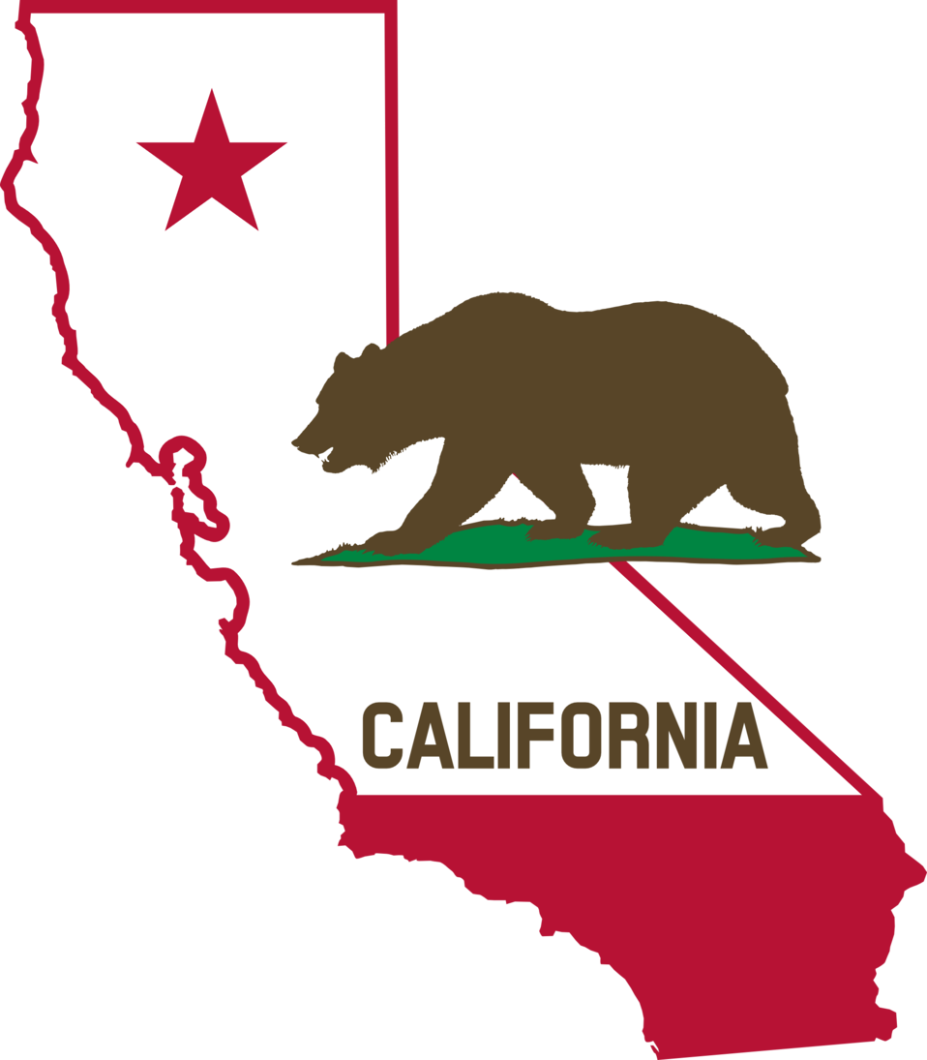

Data Information
What is our data?
5,463 observations = red & white wines from Texas and California
3,296 observations = excluding missing values and narrowing to California wines
Notes:
Our data consists of wine properties and ratings from vineyards from Texas and California. Since our customer is primarily based in California, we will be only using data from California.

Slide 4

Variables To Consider
Quality
Location sourced (California)
Chemical Properties
pH
Sulfur Dioxide
Sugars
Acidity Levels
Notes:
So what variables are some important variables for inspecting wine? Well first off we have the quality, which is a number from 1-10 being a culmination of overall taste, aroma, balance, and overall enjoyment. Then of course we have the location, which for the purposes of this study, we are looking specifically at vineyards in California.
Then we have some of the chemical properties. The chemical properties of wine play a key role in its quality. pH affects acidity, sharpness, and stability, while sulfur dioxide preserves the wine by preventing spoilage. Residual sugars determine sweetness, with higher levels producing sweeter wines, and acidity levels (fixed and volatile) contribute to structure and balance, influencing the wine’s overall taste and aroma.

Slide 5

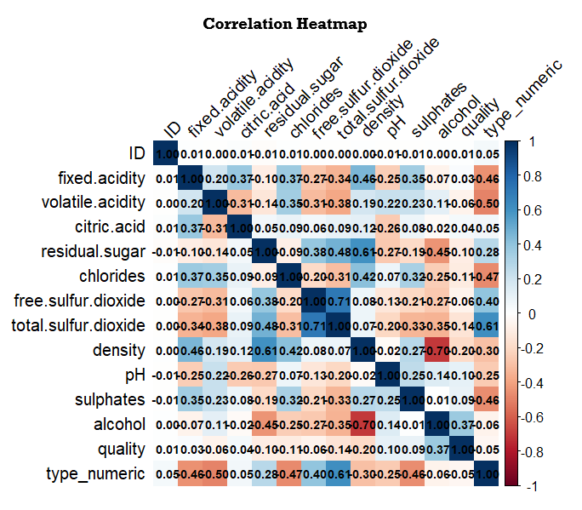
Which Variables Are Important To
Quality?
Notes:
So which variables do we think might be contributing to the quality of the wine? Well if we take a look at our correlation heat map, we can get a quick snapshot of some of the relationships in the data. To answer this question, we will need to isolate and examine the quality row. Here we can see that the first variable we should consider using is

Slide 6
KNN & Naïve Bayes Model Comparison
KNN (K=1) | Naïve Baye
improved sensitivity with SMOTE for class 4,8 except 9 | -did not improve sensitivity with SMOTE for class 4,8,9
-higher specificity for class 6 (64.12%) | -low specificity for class 6 (33.49%)
MAE is 0.463 | MAE is 0.493

Slide 7


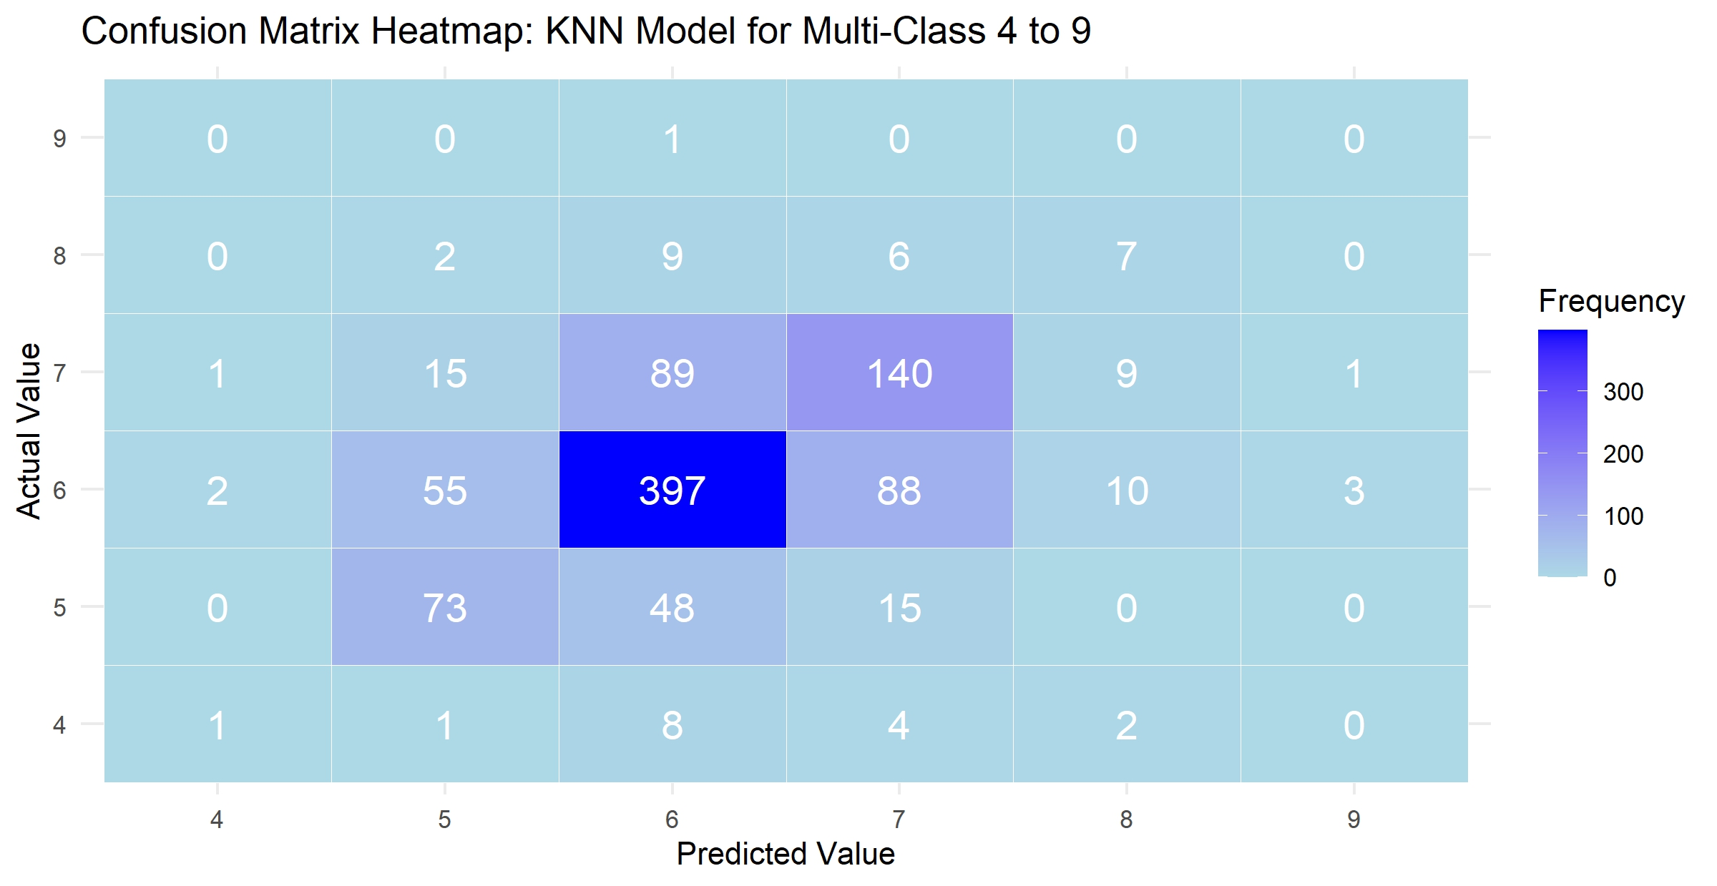
Selecting a Model: KNN
Class | 4 | 5 | 6 | 7 | 8 | 9
Sensitivity | 0.062 | 0.537 | 0.715 | 0.549 | 0.292 | 0.000
Specificity | 0.997 | 0.914 | 0.641 | 0.846 | 0.978 | 0.996
Accuracy | 0.530 | 0.725 | 0.678 | 0.697 | 0.635 | 0.498
F1 | 0.100 | 0.518 | 0.717 | 0.551 | 0.269 | -

Slide 8

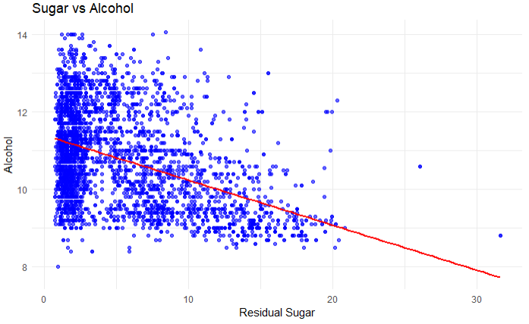
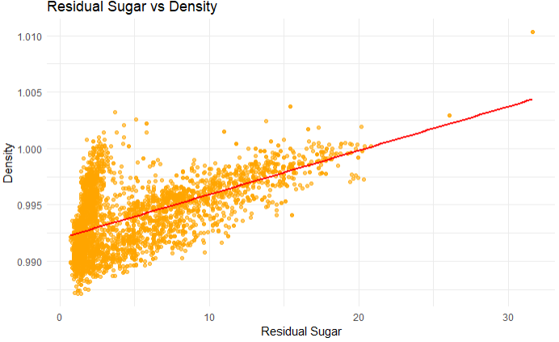
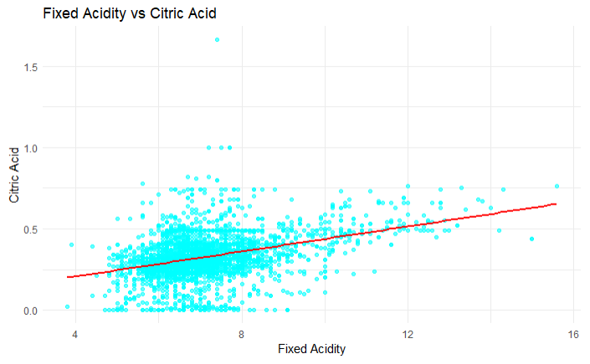
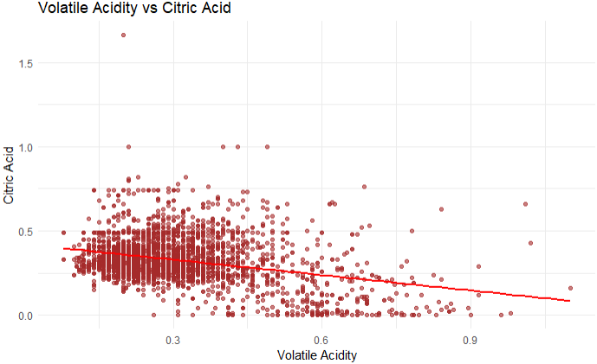
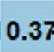
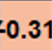
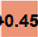
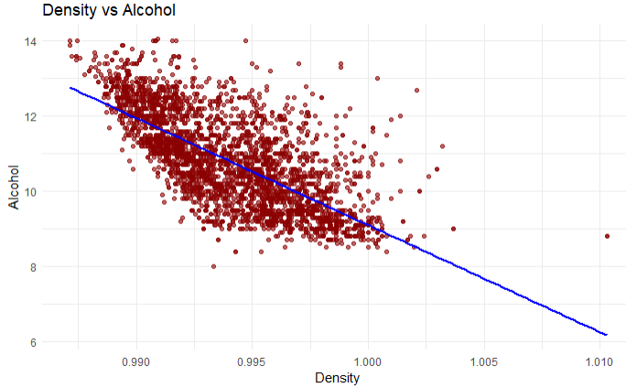
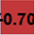
What Else Can We Learn?

Slide 9
Relationships Within The Data
Volatile Acidity
Fixed Acidity
Sugar
Density
Alcohol
Citric Acid
Sweetness
Sourness

Slide 10

Conclusion
Overall, KNN is a better predictive model than Naïve Bayes to classify wines located in California.
The Mean Absolute Error (MAE) of the KNN model is 0.463 compared to 0.493 for the Naïve Bayes model.
KNN showed moderate results for class 5,6,7 with SMOTE adjustment to unbalanced data.
The sweeter the wine is (higher residual sugars & density) the lower the alcohol level would likely be.
The citric acid level (which is associated with the wine’s sourness) decreases with volatile acidity and increases with fixed acidity.

Slide 11



Thanks!
Megan Huy
Ammar Shafi
SMU MSDS
SMU MSDS
Mhuy@mail.smu.edu
Ammar.Shafi@smu.edu

